Slide 1
CALL CENTRE DATA ANALYSIS DASHBOARD
POWER BI PROJECT PRESENTATION ON

Slide 2
PROBLEM STATEMENT
KPI’S Requirement
DASHBOARD PAGE 1 : HOME
Total Number of Calls
Call Duration in Hours
Total Call duration in Minutes
Average Call Duration in Minutes
Response Time Percentage
DASHBOARD PAGE 2 : GRID
1. Creating a Grid View Dashboard in which all the required Tables are displayed of a Call details, Displaying Row by Row Information

Slide 3
DATA EXPLAINATION
Basically the data is stored in the format of CSV file, it contains around 30,000 Rows and around 12 Columns in Total
The 12 different fields are as follows –
ID - Contains unique numbers for identification of different customers
Call TimeStamp (Date) - At which date the call received
State - From which state the call was done
Call-Centre City - Which call centre branch had attended the call
City - From which city the call was made
Channel - From which different channel it was made Call-Centre, Chat bot, Email, Web
Customer Name - Contains Name of customer which made the call
Reason - What was reason for calling – Billing Question, Service Outage, Payments
Response Time - How was the response time Within SLA, Above SLA
Sentiment - Indicates the how the call went Neutral, Positive, Negative
Call Duration in Minutes
Csat Score (Customer Satisfaction score)
3. This Contents only of October month Data

Slide 4
DATA TRANSFORMATION
Created the new Date Table which contain the minimum start date and maximum end date from the dataset
Added new column as Day to indicate which day the exact date was it .
Created the Relationship between the Date Table and Data Set Table as one to many relationship
Created new measure as Total Calls then same follows for Total Call Duration for Minutes
DAX Query for Total Call Duration for Hours
Then same calculated for Average Call Duration
Another New Measure for Response Time Percentage where it indicates as Within SLA and Above SLA

Slide 5
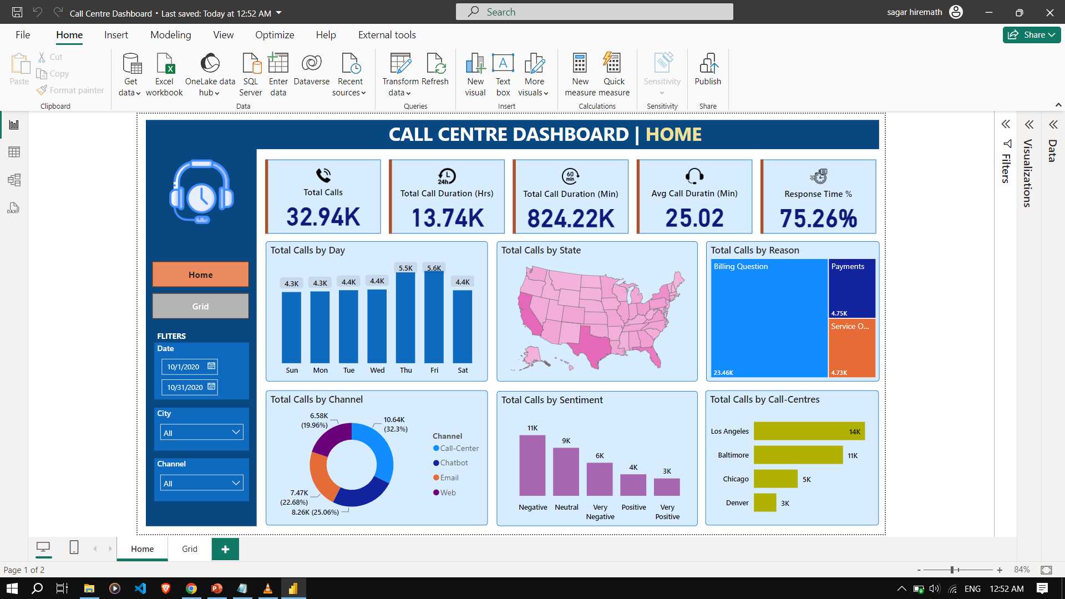

Slide 6
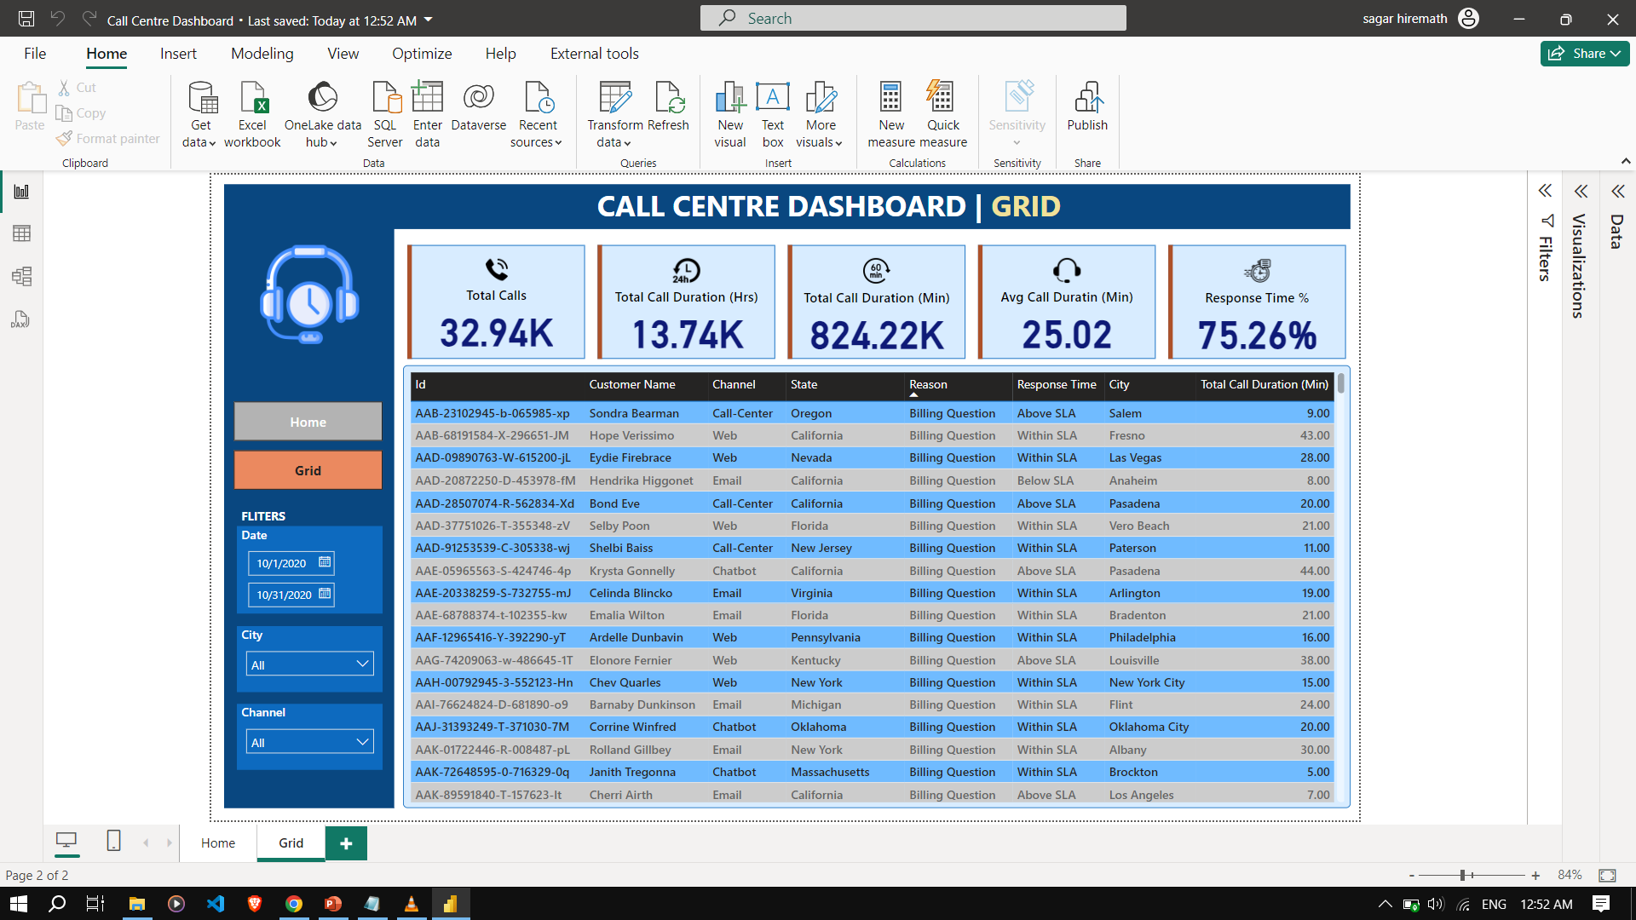

Slide 7
ADVANTAGES AND DISADVANTAGES
The Advantages are after the review it is helpful for the client to increase the growth and bring new ideas, understand in which part of area has to be improved.
Coming to Disadvantages it has limited data set around just one month so it becomes bit difficult to analyse more data and give insights

Slide 8
Applications
“
”
It is Useful for other business Clients so that they can be aware of the areas where most of the public answers the calls and make the calls for the requirement's and are active

Slide 9
CONCULSION
1. This call center data analysis dashboard in power BI has significantly improved operational efficiency and customer satisfaction through real-time insights and interactive features.
2. Moving forward, it will leverage this tool to drive continuous improvement, adapting to changing business needs and reaffirming it commitment to operational excellence and exceptional customer service.

Slide 10
THANK YOU

